Slide 1
Computer Vision and Robotics
Unit 1

Slide 2
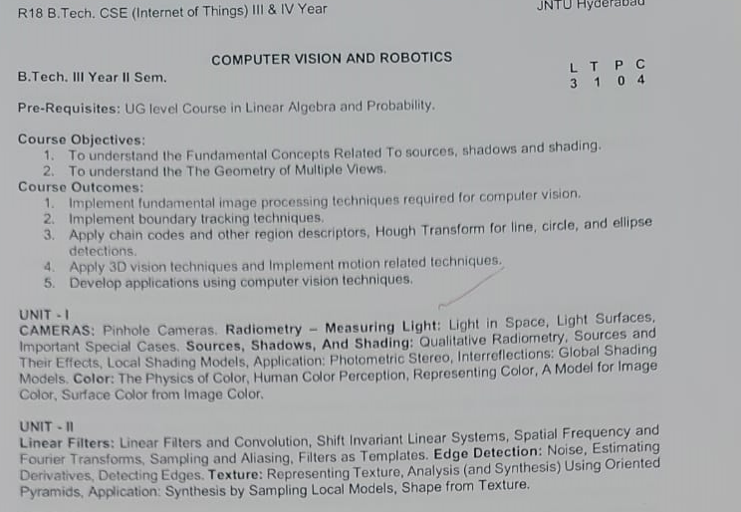
syllabus

Slide 3
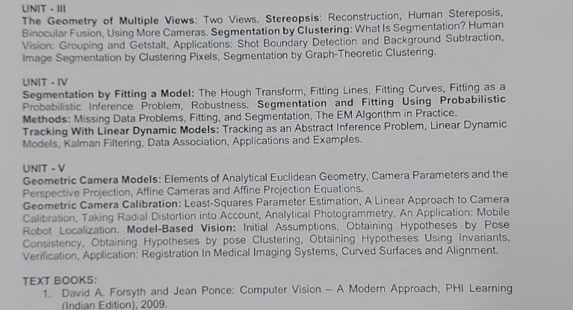
syllabus

Slide 4
Unit 1
CAMERAS:
1.Pin Hole cameras
Radiometry-Measuring Light:
2.Light in Space
3.Light surfaces,
4.Important special cases
Sources,Shadows and Shading:
5.Qualitative Radiometry,
6.Sources and Their Effects,
7.Local Shading Models,
Application:
8.Photometric Stereo,
Interreflections:
9.Global Shading Models
.
Color:
10.The Physics of Color,
11. Human Color Perception,
12.Representing Color,
13.A Model for Image Color,
14.Surface Color from Image Color

Slide 5
Computer Vision
Computer vision is a field of artificial intelligence (AI) that enables computers and systems to derive meaningful information from digital images, videos and other visual inputs — and take actions or make recommendations based on that information. If AI enables computers to think, computer vision enables them to see, observe and understand.

Slide 6
How does computer vision work?
Computer vision needs lots of data. It runs analyses of data over and over until it discerns distinctions and ultimately recognize images. For example, to train a computer to recognize automobile tires, it needs to be fed vast quantities of tire images and tire-related items to learn the differences and recognize a tire, especially one with no defects.
Two essential technologies are used to accomplish this: a type of machine learning called deep learning and a convolutional neural network (CNN).

Slide 7
The history of computer vision
Scientists and engineers have been trying to develop ways for machines to see and understand visual data for about 60 years. Experimentation began in 1959 when neurophysiologists showed a cat an array of images, attempting to correlate a response in its brain.

Slide 8
CAMERAS:
The camera is one of the most essential tools in computer vision. It is the mechanism by which we can record the world around us and use its output - photographs - for various applications.

Slide 9
Cameras
There are many types of imaging devices, from animal eyes to video cameras and radio telescopes. They may, or may not, be equipped with lenses: for example the first models of the camera obscura (literally, dark chamber) invented in the sixteenth century did not have lenses, but used instead a pinhole to focus light rays onto a wall or a translucent plate and demonstrate the laws of perspective discovered a century earlier by Brunelleschi.
Of course pinholes have many limitations (we will come back to those in a minute) and they were replaced as early as 1550 by more and more sophisticated lenses. The modern photographic or digital camera is essentially a camera obscura capable of recording the amount of light striking every small area of its backplane

Slide 10
1.Pin Hole cameras
Imagine taking a box, using a pin to prick a small hole in the center of one of its sides, and then replacing the opposite side with a translucent plate.
If you hold that box in front of you in a dimly lit room, with the pinhole facing some light source, say a candle, an inverted image of the candle will appear on the translucent plateThis image is formed by light rays issued from the scene facing the box.
If the pinhole were really reduced to a point (which is physically impossible, of course), exactly one light ray would pass through each point in the plane of the plate (or image plane), the pinhole, and some scene point.

Slide 11
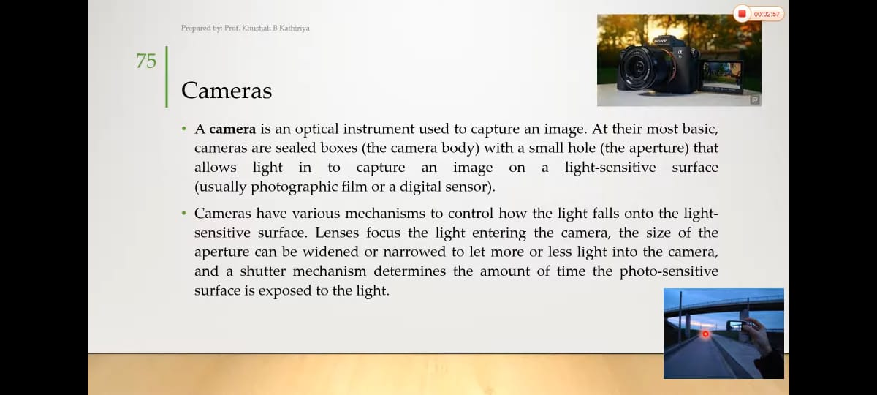

Slide 12
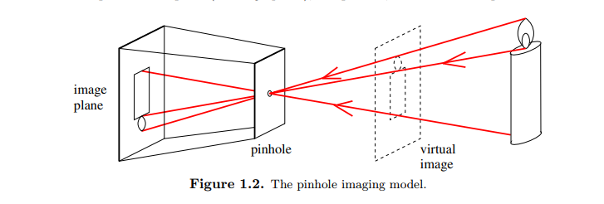
Pinhole cameras
Abstract camera model - box with a small hole in it
Perspective Projection
Notes:
12
The point to make here is that each point on the image plane sees light from only
one direction, the one that passes through the pinhole.

Slide 13
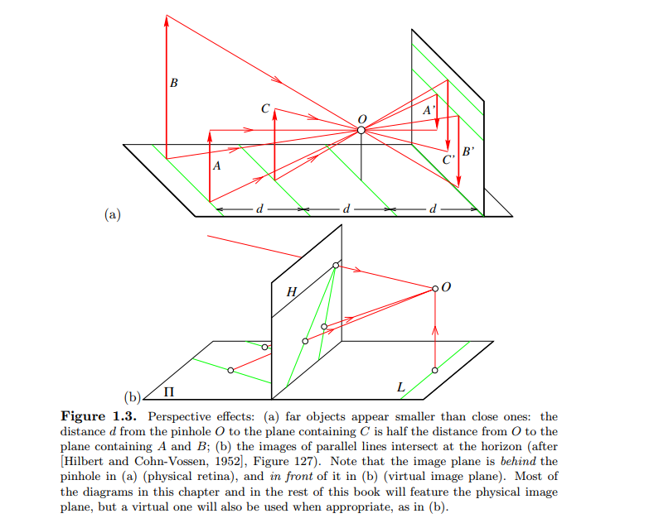

Slide 14
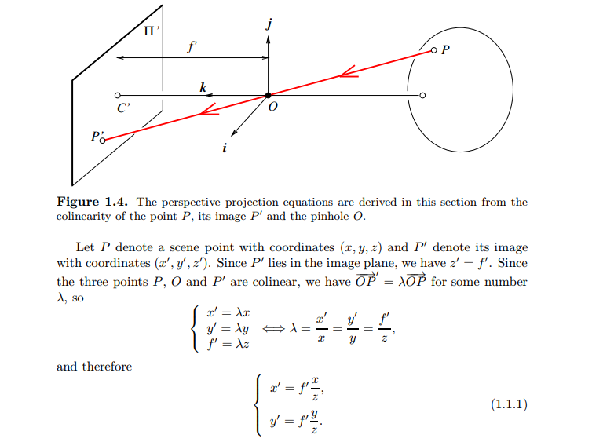

Slide 15
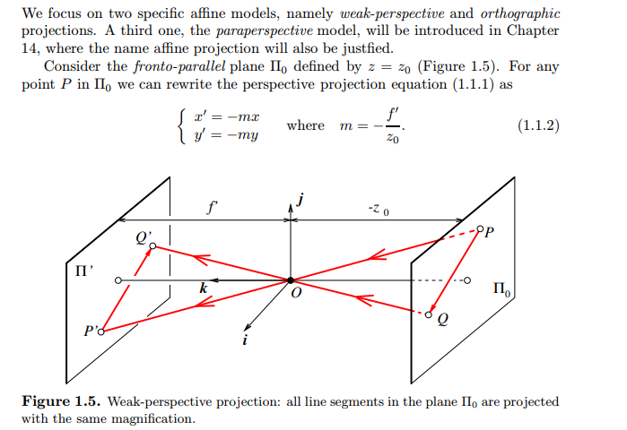
Affine projection

Slide 16
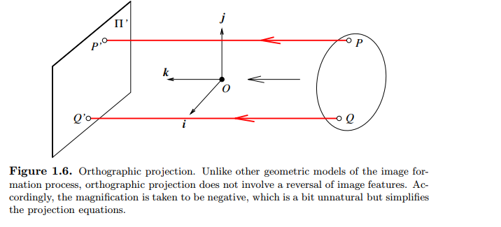
Oryhographic Projection

Slide 17
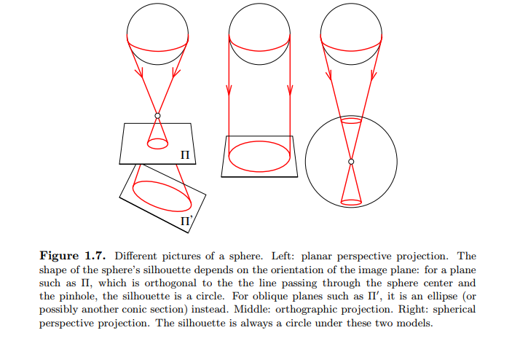
Spherical projection

Slide 18
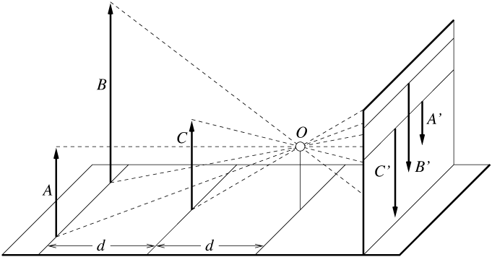
Distant objects are smaller
Computer Vision - A Modern Approach
Set: Cameras
Slides by D.A. Forsyth

Slide 19
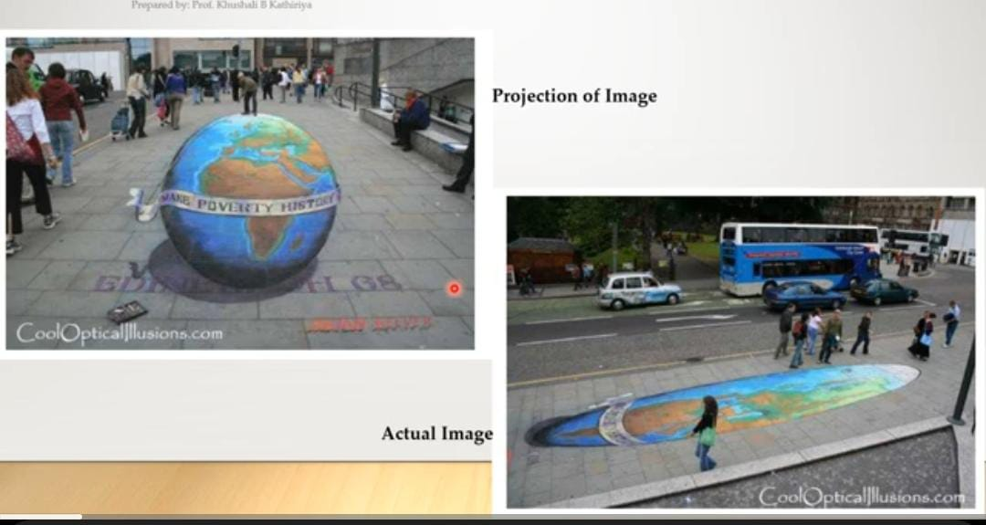

Slide 20
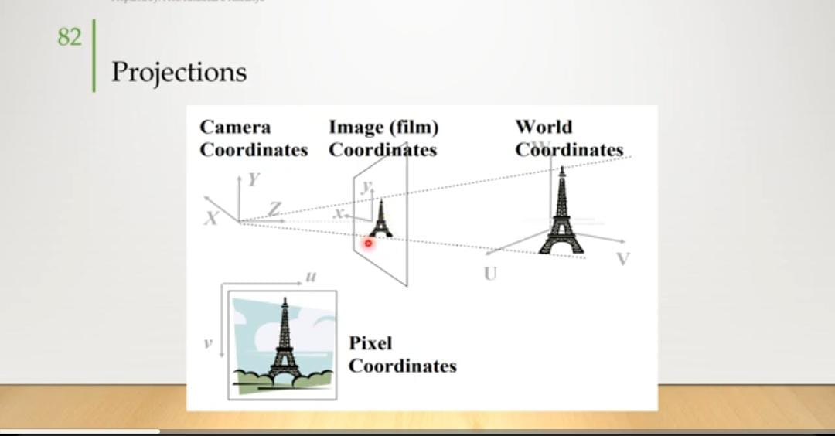

Slide 21
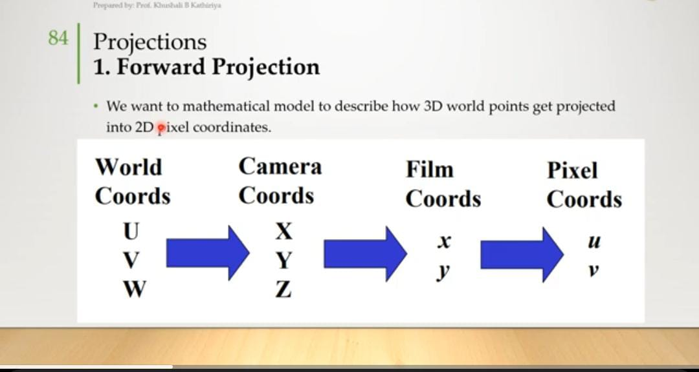

Slide 22
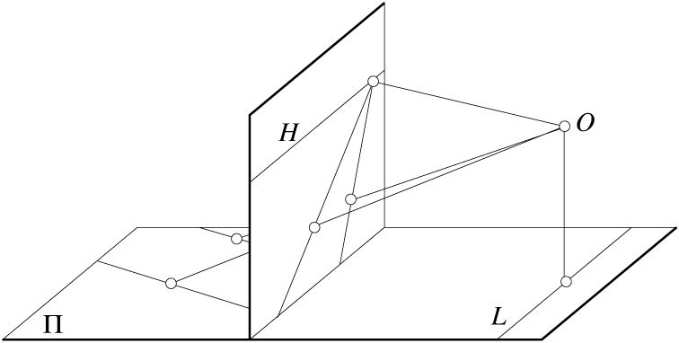
Parallel lines meet
Common to draw film plane
in front of the focal point.
Moving the film plane merely
scales the image.
Computer Vision - A Modern Approach
Set: Cameras
Slides by D.A. Forsyth

Slide 23
Vanishing points
each set of parallel lines (=direction) meets at a different point
The vanishing point for this direction
Sets of parallel lines on the same plane lead to collinear vanishing points.
The line is called the horizon for that plane
Computer Vision - A Modern Approach
Set: Cameras
Slides by D.A. Forsyth

Slide 24
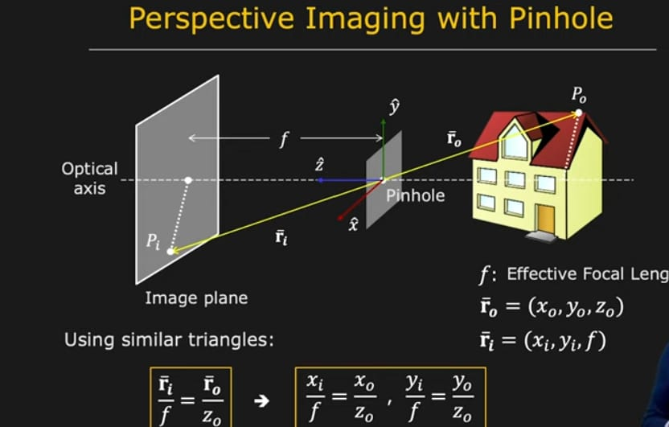

Slide 25
Intrinsic and Extrinsic parameters
Digital images, like animal retinas, are spatially discrete, and divided into (usually)
rectangular picture elements, or pixels.
intrinsic parameters, which relate the camera’s coordinate
system to the idealized coordinate system
The extrinsic
parameters, which relate the camera’s coordinate system to a fixed world coordinate
system and specify its position and orientation in space
Intrinsic Parameters
It is possible to associate with a camera a normalized image plane parallel to its
physical retina but located at a unit distance from the pinhole. We attach to this
plane its own coordinate system with an origin located at the point ĉ where the
optical axis pierces i
extrinsic parameters that define the position
and orientation of the camera relative to the world coordinate frame.

Slide 26
Homogenous coordinates
Add an extra coordinate and use an equivalence relation
for 2D
equivalence relation k*(X,Y,Z) is the same as (X,Y,Z)
for 3D
equivalence relation k*(X,Y,Z,T) is the same as (X,Y,Z,T)
Basic notion
Possible to represent points “at infinity”
Where parallel lines intersect
Where parallel planes intersect
Possible to write the action of a perspective camera as a matrix
Computer Vision - A Modern Approach
Set: Cameras
Slides by D.A. Forsyth

Slide 27
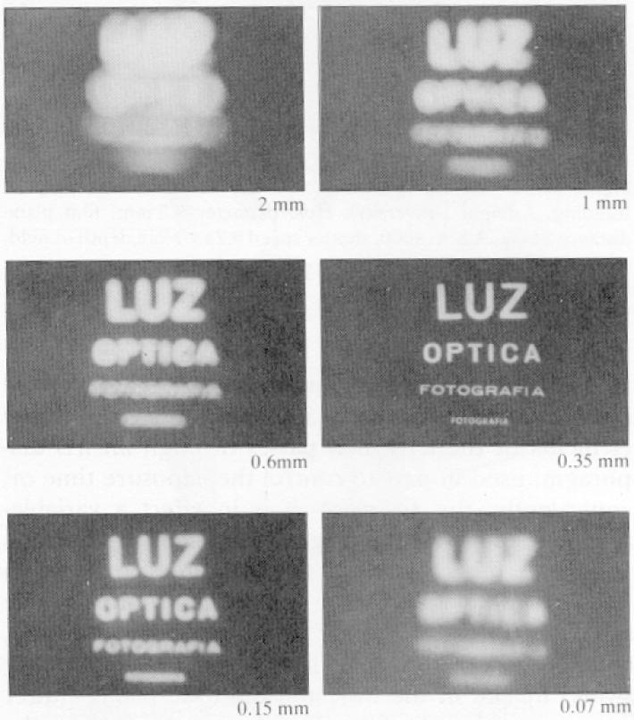
Pinhole too big -
many directions are
averaged, blurring the
image
Pinhole too small-
diffraction effects blur
the image
Generally, pinhole
cameras are dark, because
a very small set of rays
from a particular point
hits the screen.
Computer Vision - A Modern Approach
Set: Cameras
Slides by D.A. Forsyth

Slide 28
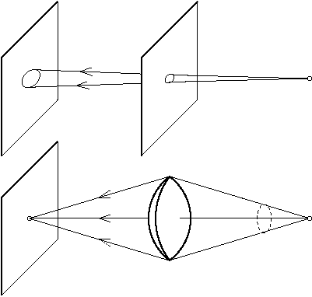
The reason for lenses
Computer Vision - A Modern Approach
Set: Cameras
Slides by D.A. Forsyth

Slide 29
Camers with Lenses
Most real cameras are equipped with lenses. There are two main reasons for this: the first one is to gather light, since a single ray of light would otherwise reach each point in the image plane under ideal pinhole projection.
Real pin holes have a finite size of course, so each point in the image plane is illuminated by a cone of light rays subtending a finite solid angle. The larger the hole, the wider the cone and the brighter the image, but a large pinhole gives blurry pictures (Figure 1.8). Shrinking the pinhole produces sharper images but reduces the amount of light reaching the image plane, and may introduce diffraction effects. Keeping the picture in sharp focus while gathering light from a large area is the second main reason for using a lens

Slide 30
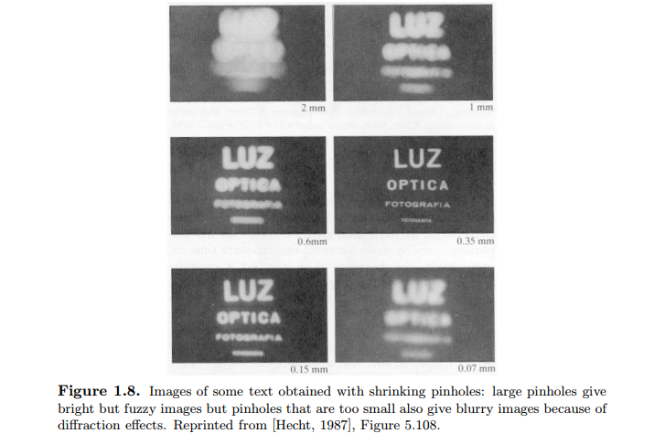

Slide 31
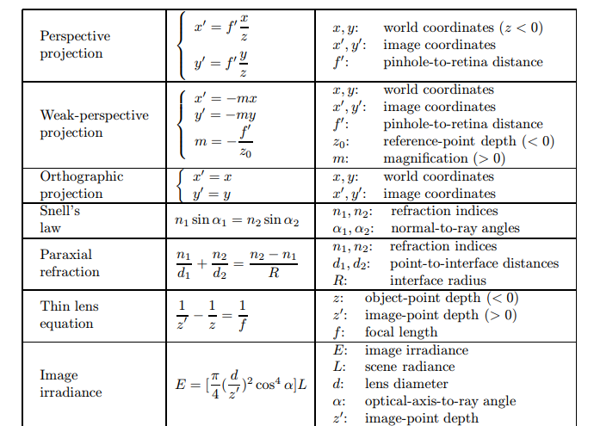

Slide 32
Problems on pinhole camera image formation
A ray of light starts at(8,4)and travels through a pinhole at (0,0).It continues until it hits an image plane 6 units behind the pinhole at a point(x1,y1).
Where does the ray hit the image plane?

Slide 33
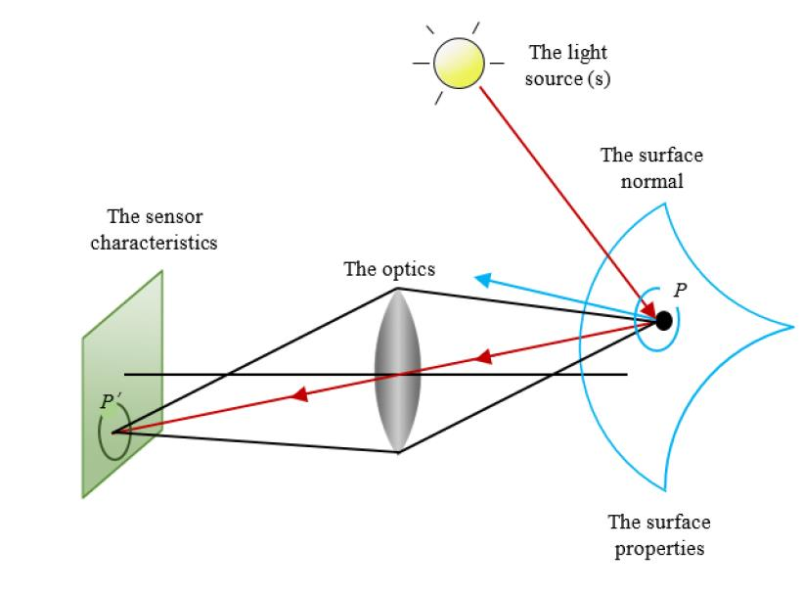
Radiometry -Measuring light 2.Light in Space
The measurement of light is a field in itself, known as radiometry

Slide 34
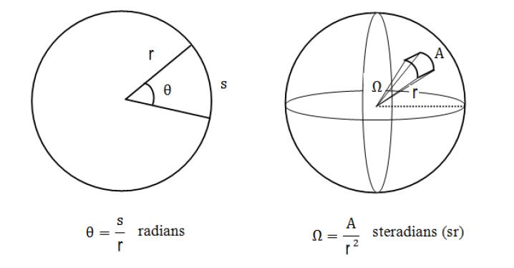
Angles and Solid angles

Slide 35
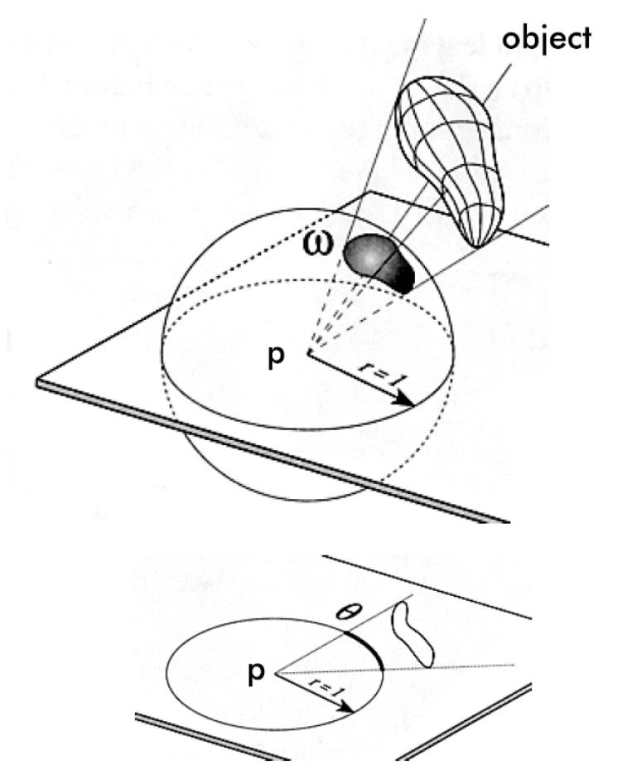
Solid angle and angle

Slide 36
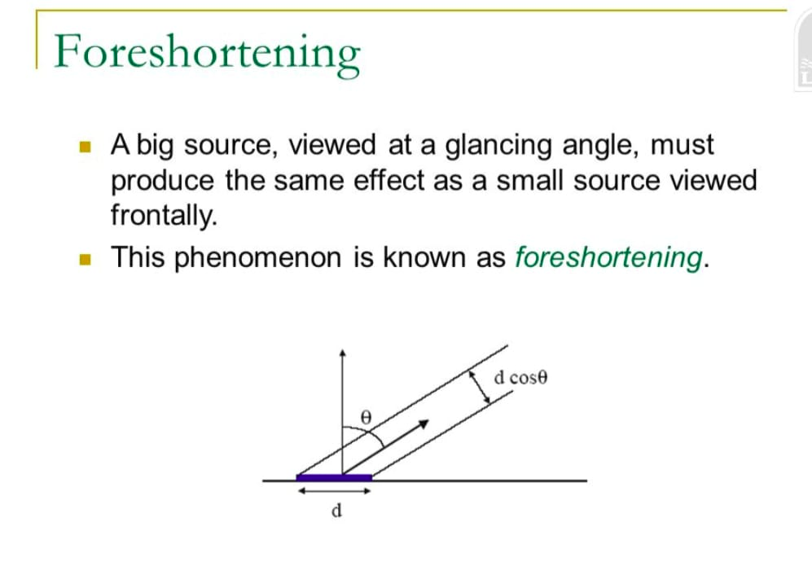

Slide 37
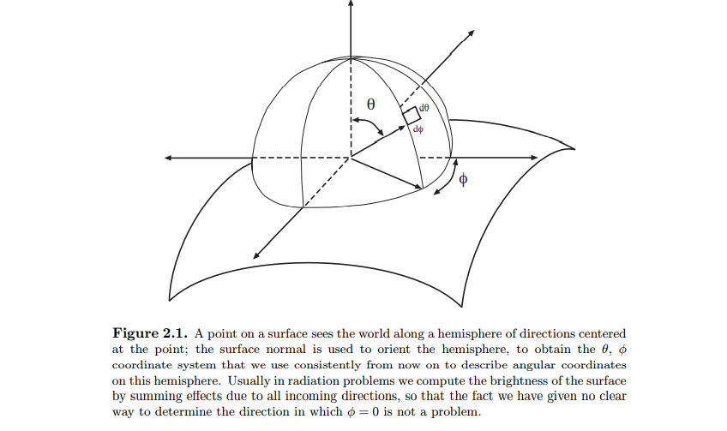

Slide 38
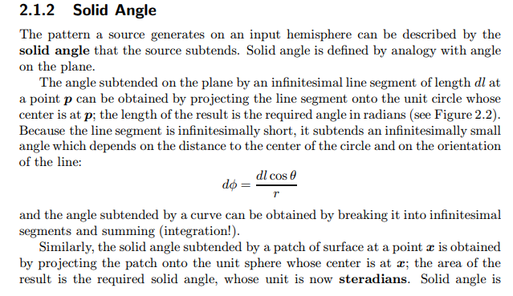

Slide 39
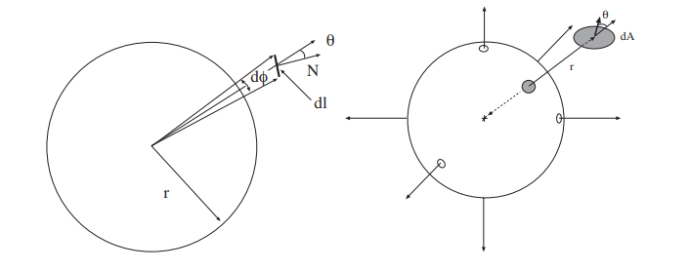

Slide 40
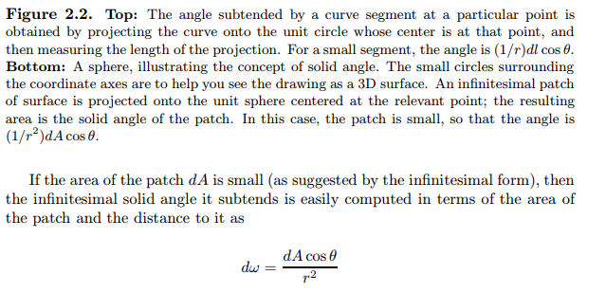

Slide 41
Radiance
The distribution of light in space is a function of position and direction. For example, consider shining a torch with a narrow beam in an empty room at night — we need to know where the torch is shining from, and in what direction it is shining.
The effect of the illumination can be represented in terms of the power an infinitesimal patch of surface would receive if it were inserted into space at a particular point and orientation. We will use this approach to obtain a unit of measurement.
Definition of Radiance The appropriate unit for measuring the distribution of light in space is radiance, which is defined as: the amount of energy travelling at some point in a specified direction, per unit time, per unit area perpendicular to the direction of travel, per unit solid angle
The units of radiance are watts per square meter per steradian (Wm−2sr−1). It is important to remember that the square meters in these units are foreshortened, i.e. perpendicular to the direction of travel

Slide 42
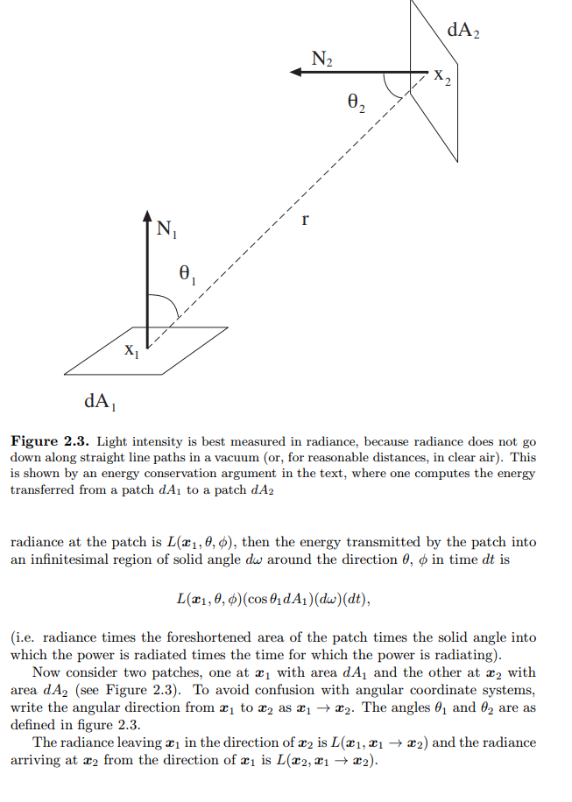

Slide 43
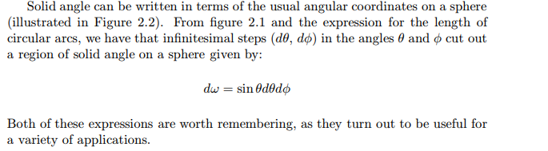
CONTD…

Slide 44
3.Light surfaces,
When light strikes a surface, it may be absorbed, transmitted, or scattered; usually, a combination of these effects occur. For example, light arriving at skin can be scattered at various depths into tissue and reflected from blood or from melanin in there; can be absorbed; or can be scattered tangential to the skin within a film of oil and then escape at some distant point.
Simplifying Assumptions
It is common to assume that all effects are local, and can be explained with a macroscopic model with no fluorescence or emission. This is a reasonable model for the kind of surfaces and decisions that are common in vision. In this model: • the radiance leaving a point on a surface is due only to radiance arriving at this point (although radiance may change directions at a point on a surface, we assume that it does not skip from point to point); • we assume that all light leaving a surface at a given wavelength is due to light arriving at that wavelength; • we assume that the surfaces do not generate light internally, and treat sources separately.

Slide 45
The Bidirectional Reflectance Distribution Function
We wish to describe the relationship between incoming illumination and reflected light.
This will be a function of both the direction in which light arrives at a surface and the direction in which it leaves.
Irradiance
The appropriate unit for representing incoming power which is irradiance, defined as: incident power per unit area not foreshortened.
A surface illuminated by radiance Li(x, θi, φi) coming in from a differential region of solid angle dω at angles (θi, φi) receives irradiance Li(x, θi, φi) cos θidω
where we have multiplied the radiance by the foreshortening factor and by the solid angle to get irradiance.
The main feature of this unit is that we could compute all the power incident on a surface at a point by summing the irradiance over the whole input hemisphere — which makes it the natural unit for incoming power.

Slide 46
The BRDF is the the most general model of local reflection is the bidirectional reflectance distribution function, usually abbreviated BRDF. The BRDF is defined as the ratio of the radiance in the outgoing direction to the incident irradiance

Slide 47
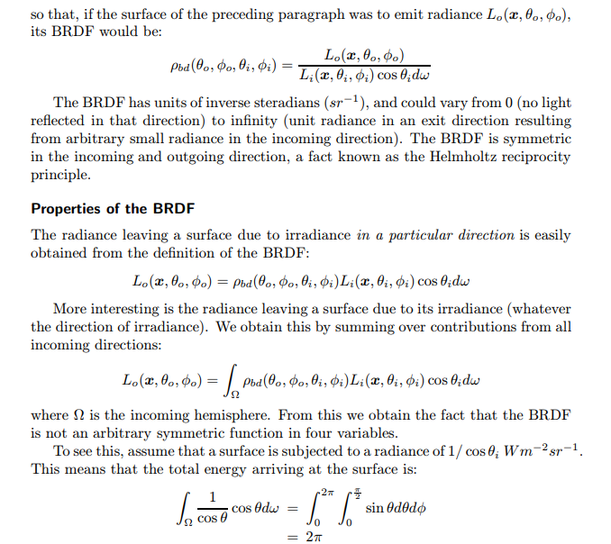

Slide 48
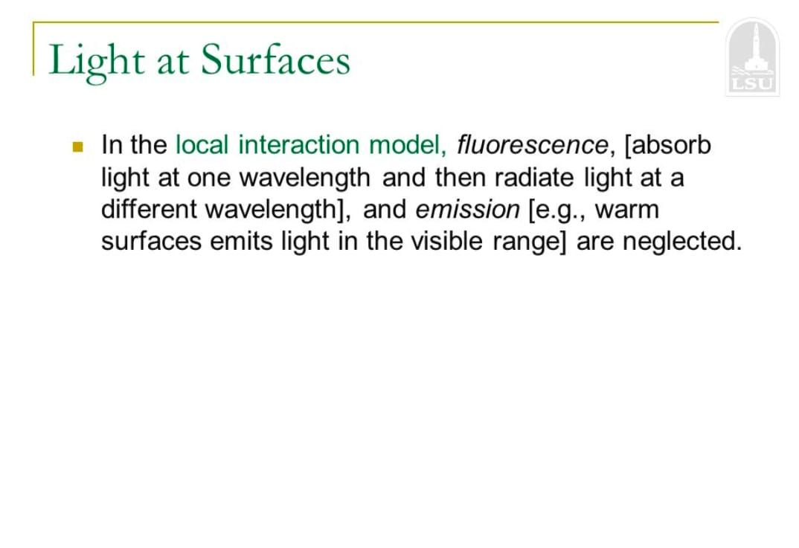

Slide 49
Surface Radiance
Light Flux emitted per unit Foreshortened area per unit solid angle

Slide 50
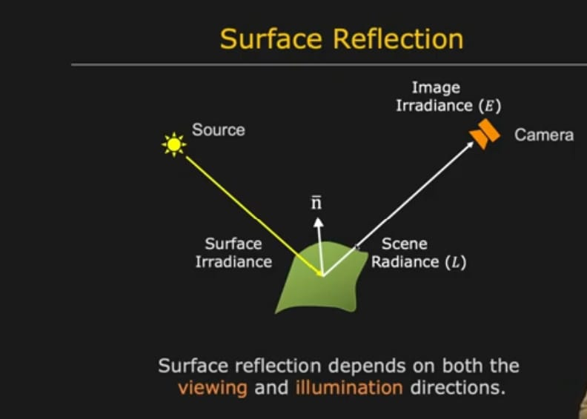
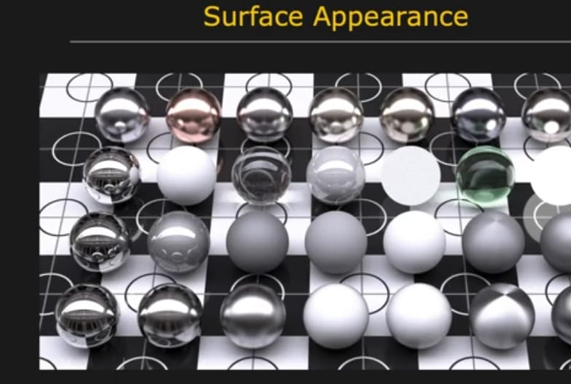

Slide 51
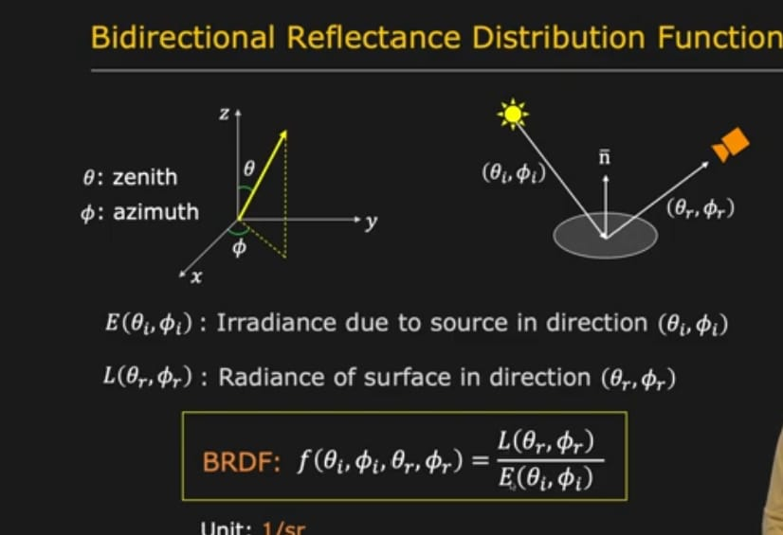

Slide 52
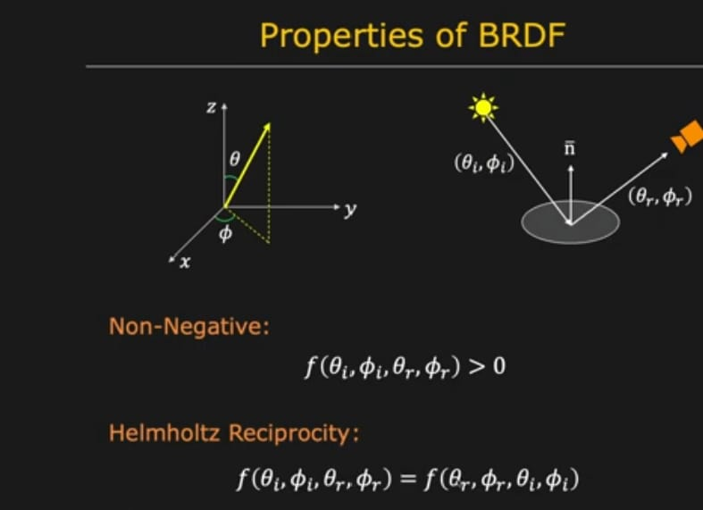

Slide 53
Surface Reflectance(Ideal Specular Model)
Body Reflactance(Lambertian Model)

Slide 54
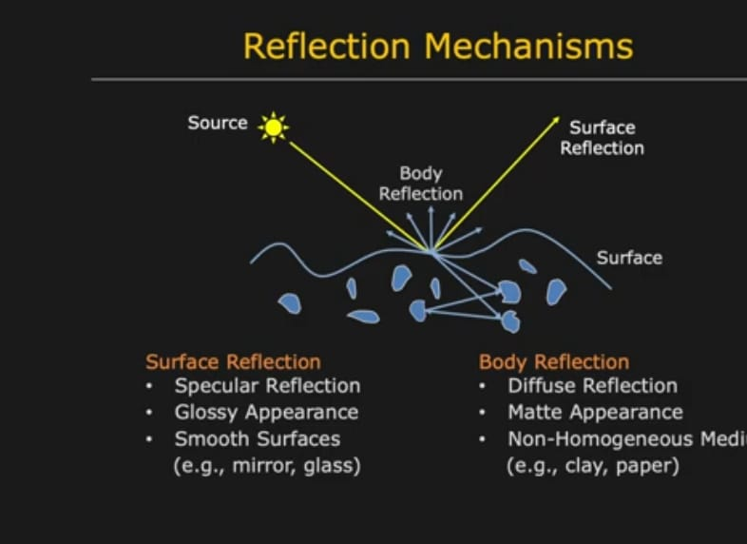

Slide 55
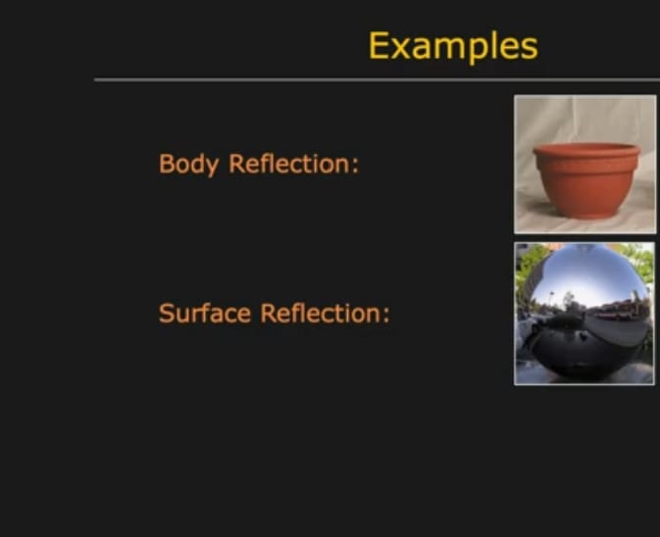

Slide 56
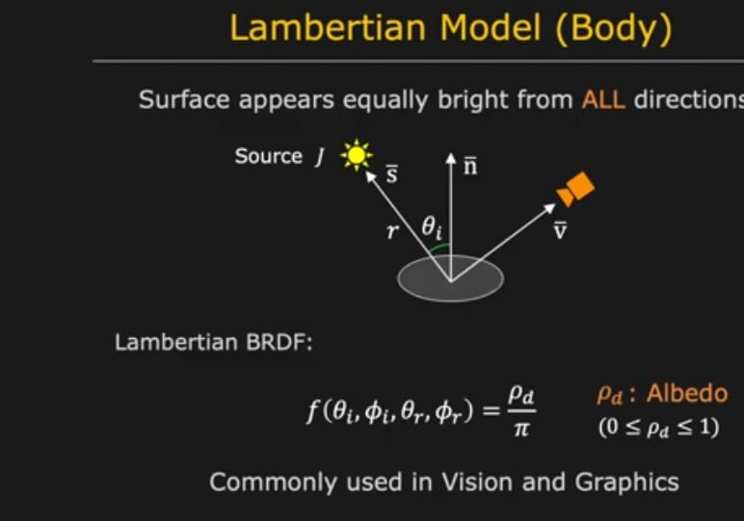

Slide 57
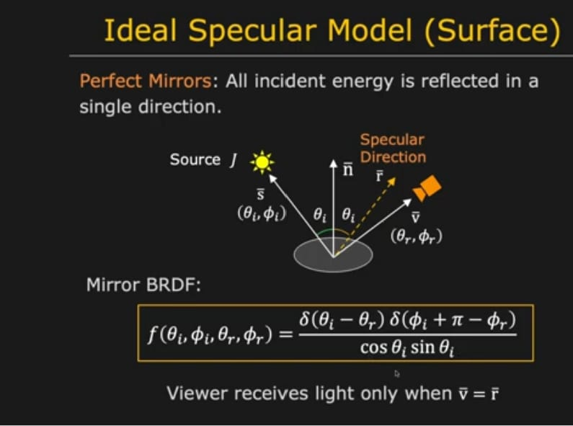

Slide 58
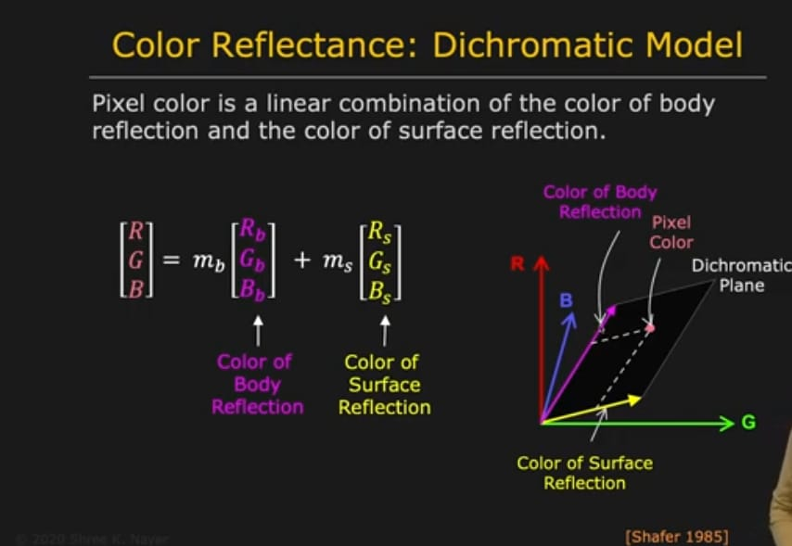

Slide 59
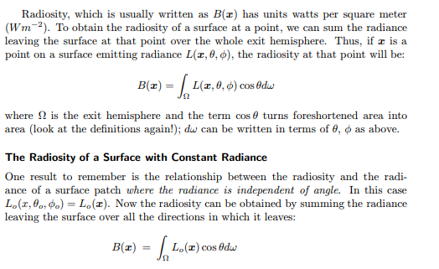
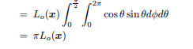
4.Important special cases
a.Radiosity If the radiance leaving a surface is independent of exit angle, there is no point in describing it using a unit that explicitly depends on direction. The appropriate unit is radiosity, defined as the total power leaving a point on a surface per unit area on the surface

Slide 60
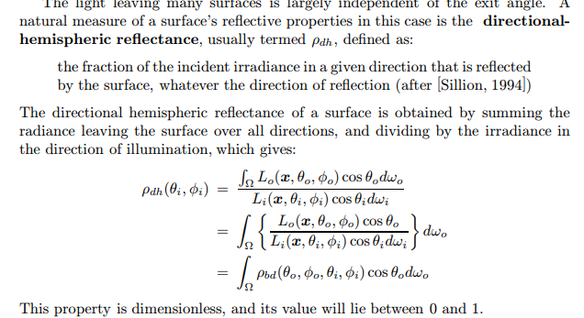
b.Directional Hemispheric reflectance

Slide 61
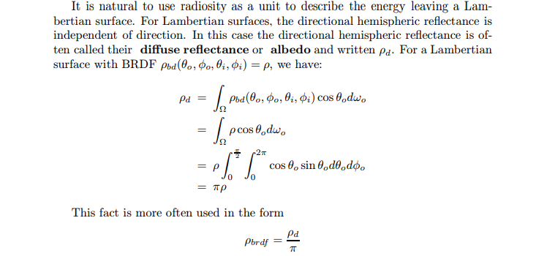
c.Lambertian Surfaces and Albedo
For some surfaces the directional hemispheric reflectance does not depend on illumination direction. Examples of such surfaces include cotton cloth, many carpets, matte paper and matte paints.
A formal model is given by a surface whose BRDF is independent of outgoing direction (and, by the reciprocity principle, of incoming direction as well). This means the radiance leaving the surface
is independent.
of angle. Such surfaces are known as ideal diffuse surfaces or Lambertian surfaces

Slide 62
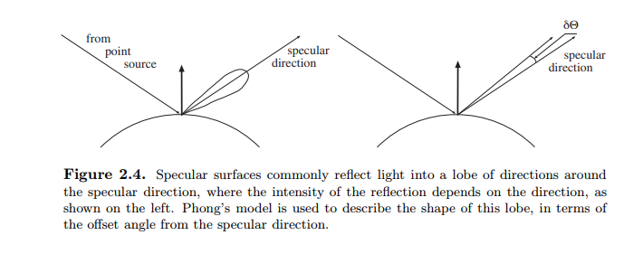
d.Specular Surfaces
Specular Surfaces A second important class of surfaces are the glossy or mirror-like surfaces, often known as specular surfaces (after the Latin word speculum, a mirror). An ideal specular reflector behaves like an ideal mirror. Radiation arriving along a particular direction can leave only along the specular direction, obtained by reflecting the direction of incoming radiation about the surface normal.

Slide 63
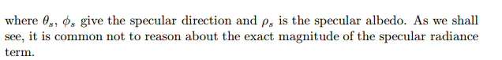
e.The Lambertian + Specular Model
The Lambertian + Specular Model Relatively few surfaces are either ideal diffuse or perfectly specular. Very many surfaces can be approximated has having a surface BRDF which is a combination of a Lambertian component and a specular component, which usually has some form of narrow lobe. Usually, the specular component is weighted by a specular albedo.

Slide 64
Sources,Shadows and Shading:

Slide 65
Radiometric Properties of Light Sources
Anything that emits light is a light source. To describe a source, we need a descrip-
tion of the radiance it emits in each direction. Typically, emitted radiance is dealt
with separately from reflected radiance. Together with this, we need a description
of the geometry of the source, which has profound effects on the spatial variation of
light around the source and on the shadows cast by objects near the source. Sources
are usually modelled with quite simple geometries, for two reasons: firstly, many
synthetic sources can be modelled as point sources or line sources fairly effectively;
secondly, sources with simple geometries can still yield surprisingly complex effects.

Slide 66
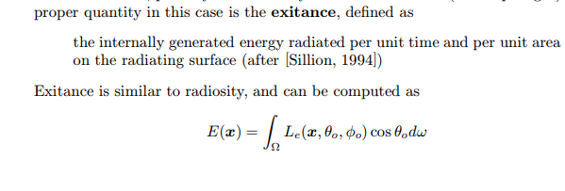
CONTD..

Slide 67
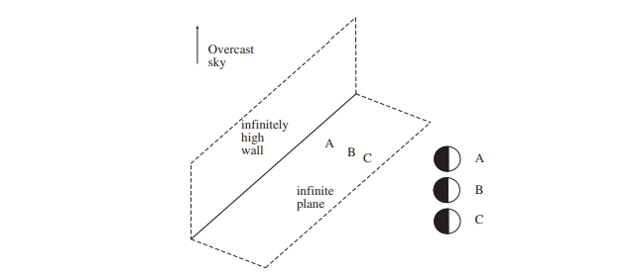
5.Qualitative Radiometry,
We should like to know how “bright” surfaces are going to be under various lighting conditions, and how this “brightness” depends on local surface properties, on surface shape, and on illumination. The most powerful tool for analysing this problem is to think about what a source looks like from the surface. In some cases, this technique us to give qualitative descriptions of “brightness” without knowing what the term means

Slide 68
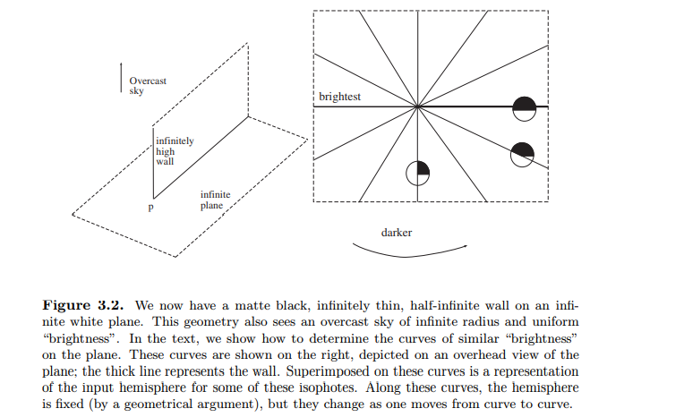
Laberts definition of “Brightness”

Slide 69
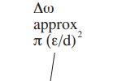

6.Sources and Their Effects,
Sources and their Effects There are three main types of geometrical source models:
point sources,
line sources and
area sources.
In this section, we obtain expressions for radiosity sources of these types produce at a surface patch

Slide 70
Showing Differences between point source,line source and area source
Point Source of Light:
Example: LED or laser pointer
Description: A point source emits light uniformly in all directions from a single point. In computer vision, point sources are often used in structured light systems for 3D reconstruction or depth sensing. They can also be used as reference points for calibration or alignment tasks.
Line Source of Light:
Example: Fluorescent tube or LED strip
Description: A line source emits light along a linear path. In computer vision, line sources are commonly used for edge detection or contour extraction. They can also be used in structured illumination techniques to enhance texture or surface detail in images.
Area Source of Light:
Example: Overhead lighting fixture or diffused LED panel
Description: An area source emits light uniformly across a surface area. In computer vision, area sources are often used for general scene illumination. They can provide even lighting conditions for image acquisition, reducing shadows and enhancing visibility of objects in the scene.

Slide 71

Point Sources
We can obtain a model for the effects of a point sources by modelling the source as a very small sphere which emits light at each point on the sphere, with an exitance that is constant over the sphere
Assume that a surface patch is viewing a sphere of radius e , at a distance r away, and that r

Slide 72


Contd..

Slide 73

Line Sources
A line source has the geometry of a line — a good example is a single fluorescent light bulb.

Slide 74

Area Sources
Area sources are important, for two reasons. Firstly, they occur quite commonly in natural scenes — an overcast sky is a good example — and in synthetic environments — for example, the fluorescent light boxes found in many industrial ceilings. Secondly, a study of area sources will allow us to explain various shadowing and interreflection effects. Area sources are normally modelled as surface patches whose emitted radiance is independent of position and of direction — they can be described by their exitance.
Assume we have a diffuse surface patch which is illuminated by an area source with exitance E(u). We use u as a coordinate on the source, and instead of writing angles in coordinates, we write u → x

Slide 75


7.Local Shading Models,
The easiest model to manipulate is a local shading model, which models the radiosity at a surface patch as the sum of the radiosity due to sources and sources alone. This model will support a variety of algorithms and theories

Slide 76


Slide 77


Slide 78



Slide 79

Shadows cast by Point source

Slide 80
Contd..
At self shadow boundaries, the surface is turning away from the light, and a ray from the patch to the source is tangent to the surface.
At cast shadow boundaries, from the perspective of the patch, the source suddenly disappears behind an occluding object. Shadows cast onto curved surfaces can have extremely complex geometries
This means that one can avoid the abstraction of reflectance and sources, and instead simply code the properties of surface and source as a reflectance map. The reflectance map is a function that takes a representation of the normal, and returns the radiosity to be expected at a point with that normal.

Slide 81


Slide 82

Application: 8.Photometric Stereo,
There are a variety of variations on photometric stereo. One interesting idea is to illuminate the surface with three lights of different colours (and in different positions) and use a colour image. For an appropriate choice of colours, this is equivalent to obtaining three images, so the measurement process is simplified. Generally, photometric stereo is used under circumstances where the illumination is quite easily controlled, so that it is possible to ensure that there is no ambient illumination in the image. It is relatively simple to insert ambient illumination into the formulation given above; we extend the matrix V by attaching a column of ones

Slide 83


Slide 84


Slide 85


Slide 86


Slide 87

height value = previous height value + corresponding p value
end
end

Slide 88


Slide 89
Interreflections: 9.Global Shading Models
Interreflections: Global Shading Models As we indicated above, local shading models can be quite misleading. In the real world, each surface patch is illuminated not only by sources, but also by other surface patches
. This leads to a variety of complex shading effects, which are still quite poorly understood. Unfortunately, these effects occur widely, and it is still not yet known how to simplify interreflection models without losing essential qualitative properties

Slide 90


Slide 91


Slide 92

Differences between Local shading and Global shading models

Slide 93
Color: 10.The Physics of Color,
Colour is a rich and complex experience, usually caused by the vision system responding differently to different wavelengths of light (other causes include pressure on the eyeball and dreams).
While the colour of objects seems to be a useful cue in identifying them, it is currently difficult to use
Radiometry for Coloured Lights: Spectral Quantities
All of the physical units we have described can be extended with the phrase “per unit wavelength” to yield spectral units. These allow us to describe differences in energy, in BRDF or in albedo with wavelength.

Slide 94
The Colour of Surfaces
The colour of surfaces is a result of a large variety of mechanisms, including differential absorbtion at different wavelengths, refraction, diffraction

Slide 95
Black Body Radiators
A body that reflects no light — usually called a black body — is the most efficient radiator of illumination. A heated black body emits electromagnetic radiation. It is a remarkable fact that the spectral power distribution of this radiation depends only on the temperature of the body. It is possible to build quite good black bodies by obtaining a hollow piece of metal and looking into the cavity through a tiny hole — very little of the light getting into the hole will return to the eye
If we write T for the temperature of the body in Kelvins, h for Planck’s constant, k for Boltzmann’s constant, c for the speed of light and λ for the wavelength,

Slide 96
The Sun and the Sky
The most important natural light source is the sun. The sun is usually modelled as a distant, bright point. Daylight is sunlight that has been subjected to scattering in the atmosphere. A patch of surface outdoors during the day is illuminated both by light that comes directly from the sun and by light from the sun that has been scattered by the air; the presence of clouds or snow can add other, important, phenomena. The colour of daylight varies with time of day (figure 4.3) and time of year
The sky is another important natural light source. A crude geometrical model is a hemisphere with constant exitance

Slide 97
Artificial Illumination
Typical artificial light sources are commonly of a small number of types. • An incandescent light contains a metal filament which is heated to a high temperature. The spectrum roughly follows the black-body law
incandescent lights in most practical cases have a reddish tinge, because the melting temperature of the element limits the colour temperature of the light source.
• Fluorescent lights work by generating high speed electrons that strike gas within the bulb; this in turn releases ultraviolet radiation, which causes phosphors coating the inside of the bulb to fluoresce. Typically the coating consists of three or four phosphors, which fluoresce in quite narrow ranges of wavelengths. Most fluorescent bulbs generate light with a bluish tinge, but bulbs that mimic natural daylight are increasingly available

Slide 98
11. Human Color Perception,
To be able to describe colours, we need to know how people respond to them. Human perception of colour is a complex function of context; illumination, memory, object identity and emotion can all play a part. The simplest question is to understand which spectral radiances produce the same response from people under simple viewing conditions
Colour Matching The simplest case of colour perception is obtained when only two colours are in view, on a black background. In a typical experiment a subject sees a coloured light — the test light — in one half of a split field. a mixture of lights in the other half to get it to match. The adjustments involve changing the intensity of some fixed number of primaries in the mixture
Write T for the test light, an equals sign for a match, the weights — which are non-negative — as wi, and the primaries Pi. A match can then written in an algebraic form as: T = w1P1 + w2P2 + ..

Slide 99


Slide 100
Trichromacy It is a matter of experimental fact that for most observers only three primaries are required to match a test light. There are some caveats. Firstly, subtractive matching must be allowed, and secondly, the primaries must be independent — meaning that no mixture of two of the primaries may match a third. This phenomenon is known as the the principle of trichromacy. It is often explained by assuming that there are three distinct types of colour transducer in the eye;
Given the same primaries and the same test light, most observers will select the same mixture of primaries to match that test light. This phenomenon is usually explained by assuming that the three distinct types of colour transducer are common to most people

Slide 101


Slide 102
Rods and Cones Anatomical investigation of the retina shows two types of cell that are sensitive to light, differentiated by their shape. The light sensitive region of a cone has a roughly conical shape, whereas that in a rod is roughly cylindrical. Cones largely dominate colour vision and completely dominate the fovea. Cones are somewhat less sensitive to light than rods are, meaning that in low light, colour vision is poor and it is impossible to read

Slide 103
12.Representing Color,
Linear Colour Spaces
There is a natural mechanism for representing colour: first, agree on a standard set of primaries, and then describe any coloured light by the three values of the weights that people would use to match the light using those primaries
. In principle, this is easy to use — to describe a colour, we set up and perform the matching experiment and transmit the match weights
However, Grassman’s laws mean that mixtures of coloured lights — at least those seen in a simple display — mix linearly, which means that a much simpler procedure is available

Slide 104
If we have a record of the weight of each primary required to match a singlewavelength source — a set of colour matching functions — we can obtain the weights used to match an arbitrary spectral radiance.
The colour matching functions — which we shall write as
f1(λ), f2(λ) and f3(λ) — can be obtained from a set of primaries P1, P2 and P3 by experiment.
Essentially, we tune the weight of each primary to match a unit radiance source at every wavelength. We then obtain a set of weights, one for each wavelength, for matching a unit radiance source U(λ).
We can write this process as U(λ) = f1(λ)P1 + f2(λ)P2 + f3(λ)P3 i.e. at each wavelength λ,
f1(λ), f2(λ) and f3(λ) give the weights required to match a unit radiance source at that wavelength.
The source — which we shall write S(λ) — is a sum of a vast number of single wavelength sources, each with a different intensity.

Slide 105

The source — which we shall write S(λ) — is a sum of a vast number of single wavelength sources, each with a different intensity.

Slide 106
The CIE XYZ Colour Space
The CIE XYZ colour space is one quite popular standard. The colour matching functions were chosen to be everywhere positive, so that the coordinates of any real light are always positive.
CMY and Black
there are three primaries: cyan (a blue-green colour); magenta (a purplish colour) and yellow. These primaries should be thought of as subtracting a light primary from white light; cyan is W − R (white-red); magenta is W − G (white-green) and yellow is W − B (white-blue).
(W − R)+(W − G) = R + G + B − R − G = B

Slide 107

Non-linear Colour Spaces
hue — the property of a colour that varies in passing from red to green; saturation — the property of a colour that varies in passing from red to pink; and brightness (sometimes called lightness or value) — the property that varies in passing from”black to white.

Slide 108

13.A Model for Image Color,
To interpret the colour values reported by a camera, we need some understanding of what cameras do, and of what physical effects we wish to model. Our model will support several quite simple and powerful inference algorithms

Slide 109
Cameras Most colour cameras contain a single imaging device. At each sensory element there is one of three filters to give it the desired spectral sensitivity function (roughly, red, green and blue). These filters are arranged in a mosaic; a variety of different patterns is used. The output of the CCD is then processed to reconstruct full red, green and blue images.

Slide 110


Slide 111

and i(x) is a term that accounts for coloured interreflections, spatial changes in illumination, and the like

Slide 112
14.Surface Color from Image Color.
It would be attractive to have a colour constancy algorithm that could take an image, discount the effect of the light, and report the actual colour of the surfaces being viewed. Colour constancy is an interesting subproblem that has the flavour
It would be attractive to have a colour constancy algorithm that could take an image, discount the effect of the light, and report the actual colour of the surfaces being viewed.
Colour constancy is an interesting subproblem that has the flavour

Slide 113

Surface Colour Perception in People
There is some form of colour constancy algorithm in the human vision system.
Colour constancy is neither perfectly accurate, nor unavoidable. Humans can report:
• the colour a surface would have in white light (often called surface colour);
• colour of the light arriving at the eye, a skill that allows artists to paint surfaces illuminated by coloured lighting;
• and sometimes, the colour of the light falling on the surface

Slide 114

Inferring Lightness
A Simple Model of Image Brightness
The radiance arriving at a pixel depends on the illumination of the surface being viewed,
its BRDF, its configuration with respect to the source and the camera responses

Slide 115


Slide 116


Slide 117


Slide 118


Slide 119

Surface Colour from Finite Dimensional Linear Models

